Slide 1
Capstone Engagement
Assessment, Analysis, and Hardening of a Vulnerable System

Slide 2
Table of Contents
This document contains the following sections:
01
Network Topology
02
Red Team: Security Assessment
03
Blue Team: Log Analysis and Attack Characterization
Hardening: Proposed Alarms and Mitigation Strategies
04

Slide 3
Network Topology
‹#›

Slide 4
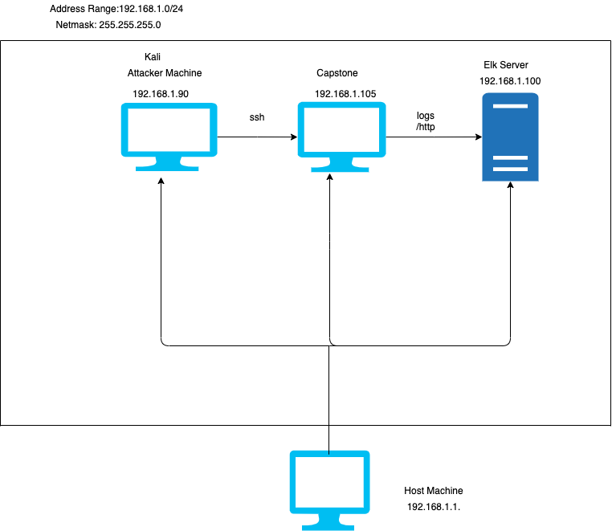
Network Topology
Network
Address Range: 192.168.1.0/24
Netmask: 255.255.255.0
Gateway: 192.168.1.1
Machines
IPv4: 192.168.1.90
OS: Linux
Hostname: Kali
IPv4:192.168.1.105
OS: Linux
Hostname: Capstone
IPv4:192.168.1.100
OS: Linux
Hostname: Elk Server
IPv4:192.168.1.1
OS: Windows
Hostname: Host Machine

Slide 5

Red Team
Security Assessment
‹#›

Slide 6
Recon: Describing the Target
Nmap identified the following hosts on the network:
Hostname | IP Address | Role on Network
Kali | 192.168.1.90 | Attacking Machine
Capstone | 192.168.1.105 | Target Machine
Elk Server | 192.168.1.100 | Collects and processes data from multiple data sources
Host Machine | 192.168.1.1 | Cloud based Host machine (Azure)

Slide 7
Vulnerability Assessment
The assessment uncovered the following critical vulnerabilities in the target:
Vulnerability | Description | Impact
Port 80 | Open port 80 allows anyone to enter and have access | Allows the attacher machine to easily enter the target machine and access control to files
Using login credentials to view other user’s login information | Storing another user’s login information that is in plain text, but not encrypted | Ryan’s login information was found in Ashton
Brute force Vulnerability | Attempting to log in with multiple username and password combinations. | Used tools like rockyou.txt and John the ripper to retrieve the login information.
Hashed password | If the password is not salted, then it can be easily cracked using other tools such as crackstation | Ryan’s login information was in hash form.

Slide 8
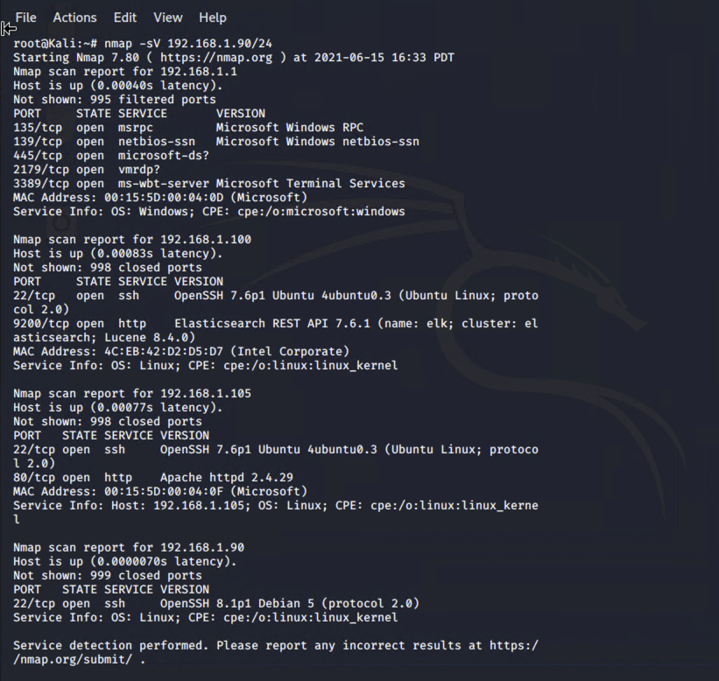
Exploitation: [Vulnerability of Port scan]
01
02
03
Tools & Processes
How did you exploit the vulnerability? Nmap -sV 192.168.1.90/24
Achievements
The nmap command was used to check for open ports on the target machine. It listed as 4 hosts up. Using the list of IP addresses to see which browser we could connect to.
Nmap -sV 192.168.1.90/24

Slide 9
Exploitation: [Brute Force Vulnerability]
01
02
03
Tools & Processes
How did you exploit the vulnerability? By using the hydra command to find the common password lists for ashton
Achievements
What did the exploit achieve?
It achieved the password for Ashton and access the secret_folder where Ryan’s hash password was stored.
Hydra -l ashton -P usr/share/wordlists/rockyou.txt -s 80 -f -vV 192.168.1.105 http-get /company_folders/secret_folder

Slide 10
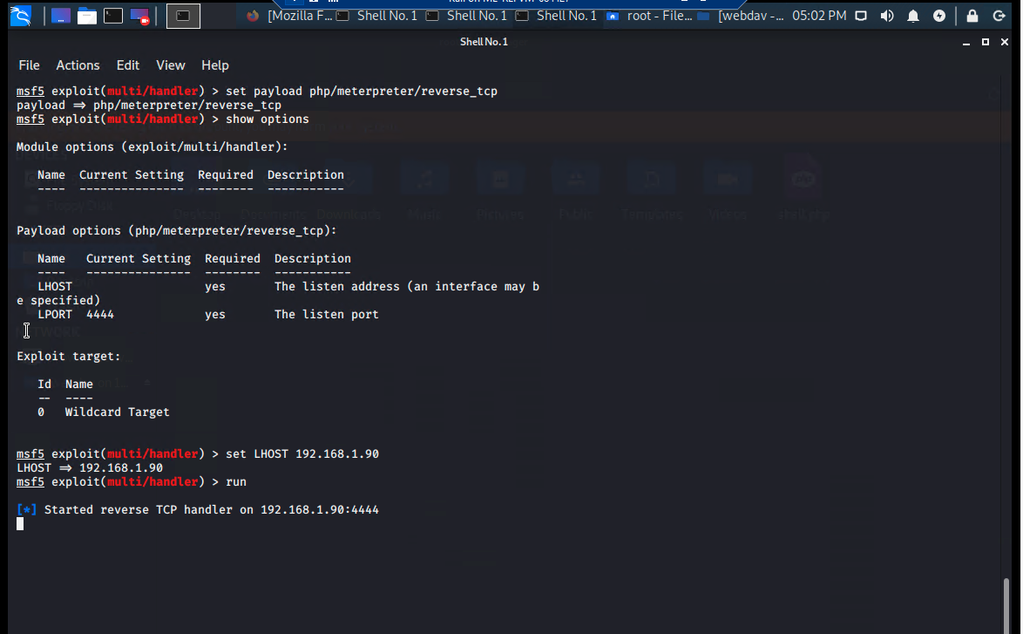
Exploitation: [LFE Vulnerability ]
01
02
03
Tools & Processes
How did you exploit the vulnerability? We used the msfconsole and msfvenom to set and upload payload on the target machine
Achievements
What did the exploit achieve? The exploit achieved by allowing access to the shell of the target machine.
[INSERT: ]

Slide 11

Blue Team
Log Analysis and Attack Characterization
‹#›

Slide 12

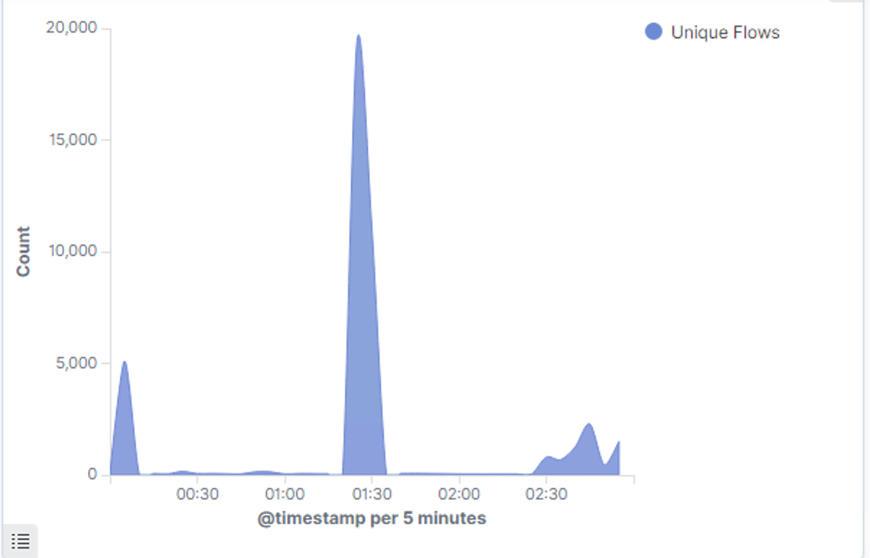
Analysis: Identifying the Port Scan
.
What time did the port scan occur? June 11, 2021 1:52:54.206
How many packets were sent, and from which IP? 15,221 packets
What indicates that this was a port scan? There was a sudden peak in the network traffic

Slide 13
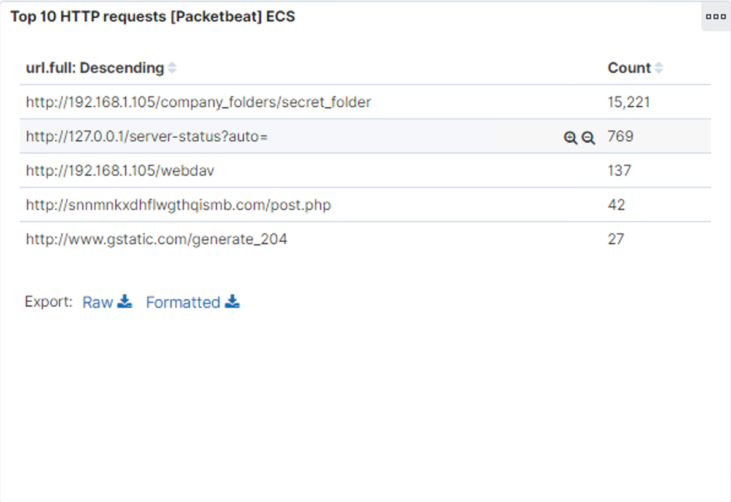
Analysis: Finding the Request for the Hidden Directory
What time did the request occur? How many requests were made? 15,221 requests at June 11, 2021 @ 1:29:44 PM
Which files were requested? What did they contain? /company_folders/secret_folder. It contains a hash password for Ryan and instructions on how to connect to company server.
What time did the requet occur? How many requests were made?
Which files were requested? What did they contin?

Slide 14
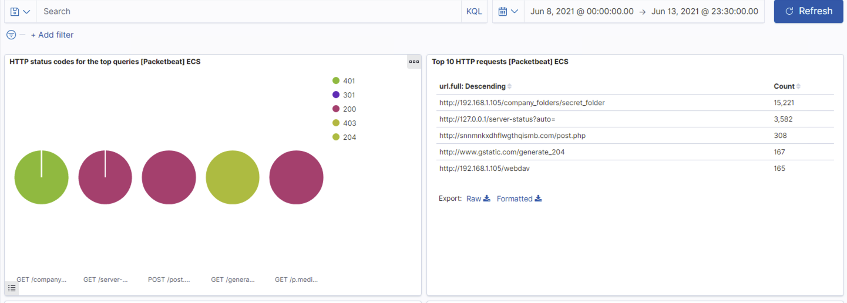
Analysis: Uncovering the Brute Force Attack
Answer the following questions in bullet points under the screenshot if space allows. Otherwise, add the answers to speaker notes.
How many requests were made in the attack? 15,221 requests
How many requests had been made before the attacker discovered the password? 207 requests

Slide 15
Analysis: Finding the WebDAV Connection
Answer the following questions in bullet points under the screenshot if space allows. Otherwise, add the answers to speaker notes.
How many requests were made to this directory? 137 requests
Which files were requested? Password file

Slide 16
Blue Team
Proposed Alarms and Mitigation Strategies
‹#›

Slide 17
Mitigation: Blocking the Port Scan
What kind of alarm can be set to detect future port scans?
Alert to go off upon number of port scan requests per second
What threshold would you set to activate this alarm?
Alarm should be activated if there are 10 port scans requests for more than 5 seconds from any given IP addresses.
What configurations can be set on the host to mitigate port scans?
Closed unused ports
Regularly run the port scan to detect any open ports
Describe the solution. If possible, provide required command lines
Nmap -sV ip address net range

Slide 18
Mitigation: Finding the Request for the Hidden Directory
What kind of alarm can be set to detect future unauthorized access?
Create an alert whenever someone tries to access the company folder.
What threshold would you set to activate this alarm? Unauthorized IP addresses trying to access will activate the alarm.
What configuration can be set on the host to block unwanted access?
-Keep the company directory host private instead of public.
- encrypt the data
Describe the solution. If possible, provide required command lines.

Slide 19
Mitigation: Preventing Brute Force Attacks
What kind of alarm can be set to detect future brute force attacks?
If there are 5 attempts of bruteforce.
What threshold would you set to activate this alarm?
If there are more than 100 login attempts then it will activate the alarm
What configuration can be set on the host to block brute force attacks?
Limit the number of login attempts
Creating password policy
IP blacklisting
Describe the solution. If possible, provide the required command line(s).

Slide 20
Mitigation: Detecting the WebDAV Connection
What kind of alarm can be set to detect future access to this directory?
- Monitor when external ip addresses tries to access the directory.
What threshold would you set to activate this alarm?
Block external IP address unless they are on the IP address whitelist.
What configuration can be set on the host to control access?
Give privileges to certain users
Limit access to the directory.
Describe the solution. If possible, provide the required command line(s).

Slide 21
Mitigation: Identifying Reverse Shell Uploads
What kind of alarm can be set to detect future file uploads?
Upload of a suspicious .php file can alert an alarm.
What threshold would you set to activate this alarm? Alarm should be activated when uploading a malicious file.
What configuration can be set on the host to block file uploads?
-Block all unnecessary ports and deny all external IP addresses.
- Filebeat configured and enabled
Describe the solution. If possible, provide the required command line.

